Slide 1
ROUTE OPTIMIZATION FOR GRAYBAR’S WAREHOUSE
Adithya Jaikumar, Aishwarya Anandan, Haridut Athi, Jaydeep Chanduka

Slide 2
Overview
Introduction
Problem Statement
Input Data
Problem Formulation
Solution Methodology
Results

Slide 3
Introduction
Warehouse Management System (WMS)
Graybar Electric Inc. – A Fortune 500 company
Second largest electric optic fiber cable distributor
255 manual warehouses, 17 distribution centers
Graybar’s largest warehouse – Glendale Heights, IL
Spans an area of 90,000 sq.ft
Warehouse holds 110,000 SKUs

Slide 4
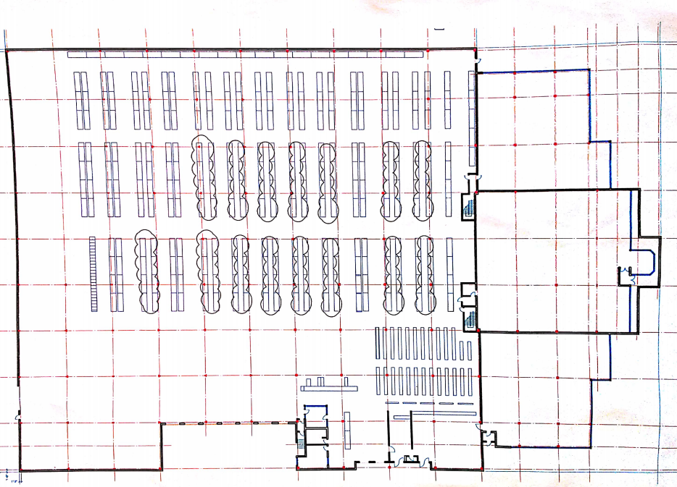
Problem Statement
Develop an efficient model for optimizing the routes for pick and place operations at Glendale Heights
Save costs of wasted labor and other hidden costs

Slide 5
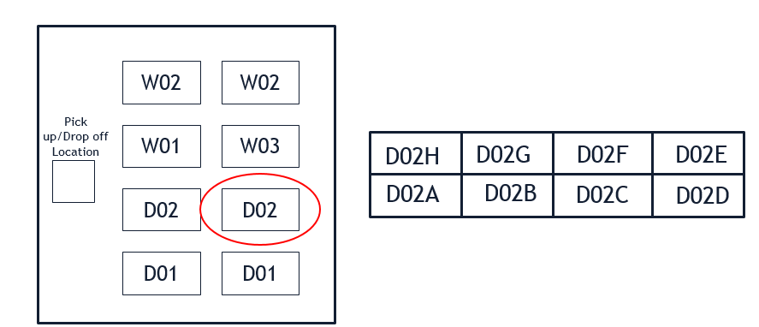

Input Data
Warehouse layout
Stock Keeping Units (SKUs) in the warehouse
Bin locations of each SKUs
Quantity available of each SKU at each of its location
Order list inclusive of the quantity required
Locations are represented as an alphanumeric sequence of 4 characters
Sample order ticket

Slide 6
Problem Modeling
Challenge: Each rack structure poses a barrier for travel.
Solution: Impose a grid structure on the layout, grid intersection points ≡ nodes, grid segments ≡ edges of input graph.
Pick up for each SKU is from the midpoint of the outer edge of its rack location.
W02
W02
Pick up/Drop off Location
W01
W03
D02
D02
D01
D01
D02H
D02G
D02F
D02E
D02A
D02B
D02C
D02D

Slide 7
Problem Modeling
Challenge: Each rack structure poses a barrier for travel.
Output: G(V,E) that ensures travel is restricted through barriers.
Perform Floyd-Warshall’s all-pair shortest path algorithm on G.
Distance matrix constructed.
Nodes
Edges

Slide 8
Problem Formulation
Decision Variables

Slide 9
Problem Formulation

Slide 10
Challenges
Multiple locations for some SKUs.
Different SKUs at the same location.
Different quantities at different locations.

Slide 11
Solution approach
3 variants of original problem considered in the order of increasing complexity:
1. Infinite quantity, single location
Randomly select one location for each SKU.
2. Infinite quantity, multiple locations
Select the location that guarantees minimum distance travelled.
3. Finite quantity, multiple locations
Select the location(s) that satisfy the quantity requirements, and ensure minimum travel distance.
Variant 1 – Infinite quantity, single location
Variant 2 – Infinite quantity, multiple locations
Solved using Multiloc - Heuristic
Variant 3 – Finite quantity, multiple locations
Solved using Quant - Heuristic
Solved to optimality using Gurobi solver and MST based heuristic

Slide 12
Variant 1: Infinite quantity, single location
Step 1: Input Preprocessing
Input: Order Pick list
Create Graph G(V,E): V → Locations, weights on E → Shortest distance between nodes
Step 2: MST
MST is constructed for G(V,E) based on Kruskal’s Algorithm
Step 3: MST-based Heuristic
Initialize: set_A ={origin}, set_B = {v: v ϵ V /origin}
Map SKU → Location
While set_B is not empty:
k = last node in set_A
If N(k) $∉$ set_A:
If N(k) ∉ set_A:
Append N(k) to set_A
Remove N(k) from set_B
Break
Else:
Choose a node p randomly from set_B
Append p to set_A
Remove p from set_B
Best tour $S_{opt}=$ set_A (After many iterations)
Best tour 𝑆_𝑜𝑝𝑡= set_A (After many iterations)

Slide 13
Variant 2: Infinite quantity, multiple locations
Step 1: Input Preprocessing
Input: Order Pick list
Step 3: MST & MST-based heuristic
MST is constructed for G(V,E) based on Kruskal’s Algorithm
Step 4: Multiloc Heuristic
Map SKU → Location(s)
Step 2: Location Selection
For each p ϵ S
For multiple locations in same rack, retain corner locations (if exist), remove the rest.
If multiple SKUs have same location, retain that location, eliminate the rest.
Create Graph G(V,E): V → Locations, weights on E → Shortest distance between nodes
MST-Heuristic is implemented, store best route sequence, S = {1,2,…,p,…,n}
if p has multiple locations $Np$:
if p has multiple locations 𝑁_{𝑝}:
pre(p) := predecessor of p
suc(p) := successors of p
Compute $S_{p}= {argmin}_{i ϵ Np, j ϵ suc(p)} (D_{pre\left(p\right),i}+D_{i,j})$
Compute 𝑆_𝑝= 〖𝑎𝑟𝑔𝑚𝑖𝑛〗_(𝑖 ϵ 𝑁_{𝑝}, j ϵ 𝑠𝑢𝑐(𝑝)) (𝐷_(𝑝𝑟𝑒(𝑝),𝑖)+𝐷_(𝑖,𝑗))
Optimal Tour: $S_{opt}={argmin}_{pϵS} \left(S_{p}\right)$
Optimal Tour: 𝑆_𝑜𝑝𝑡=〖𝑎𝑟𝑔𝑚𝑖𝑛〗_𝑝ϵ𝑆 (𝑆_𝑝 )
else: $S_{p}=S$
else: 𝑆_𝑝=𝑆

Slide 14
Variant 3: Finite quantity, multiple locations
Step 1: Input Preprocessing
Input: Order Pick list (SKU, demand)
Map SKU → Location(s)
Step 2: Location Selection
Create Graph G(V,E): V → Locations in $L_{p}^{′}$ , weights on E → Shortest distance between nodes
Create Graph G(V,E): V → Locations in 𝐿_𝑝^′ , weights on E → Shortest distance between nodes
for each $p ε P$:
for each 𝑝 𝜖 𝑃:
$∀ p ε P$, sort the locations in $L_{p}$ in the order of increasing quantity
∀ 𝑝 𝜖 𝑃, sort the locations in 𝐿_𝑝 in the order of increasing quantity
$∀ p ε P$, create list $L_{p}=\{set of all locations of p^{th} SKU\}$
∀ 𝑝 𝜖 𝑃, create list 𝐿_𝑝={𝑠𝑒𝑡 𝑜𝑓 𝑎𝑙𝑙 𝑙𝑜𝑐𝑎𝑡𝑖𝑜𝑛𝑠 𝑜𝑓 𝑝^𝑡ℎ 𝑆𝐾𝑈}
Create list_C $= \bigcup_{p ε P}{L_{p}^{′}}$
Create list_C = ⋃_(𝑝 𝜖 𝑃)▒𝐿_𝑝^′
for $i ε L_{p}$:
for 𝑖 𝜖 𝐿_𝑝:
Create $L_{p}^{′}=\{ \}$
Create 𝐿_𝑝^′={ }
$qty\left(i\right)$ denotes the quantity of material $p$ at location $i$
𝑞𝑡𝑦(𝑖) denotes the quantity of material 𝑝 at location 𝑖
Append i to $L_{p}^{′}$ if $\sum_{k ε L_{p}^{′} }{qty\left(k\right)<D(p)}$
Append i to 𝐿_𝑝^′ if ∑8_(𝑘 𝜖 𝐿_𝑝^′ )▒〖𝑞𝑡𝑦(𝑘)<𝐷(𝑝)〗
Define $P =\{1,2,…,p,…n\}$ as the set of all SKUs
Define P ={1,2,…,𝑝,…𝑛} as the set of all SKUs
Define $D=\{demand(1),…,demand(p),…,demand(n)\}$
Define D={𝑑𝑒𝑚𝑎𝑛𝑑(1),…,𝑑𝑒𝑚𝑎𝑛𝑑(𝑝),…,𝑑𝑒𝑚𝑎𝑛𝑑(𝑛)}
Create list_B = $\bigcup_{p ε P}{L_{p}^{′}(1)}$
Create list_B = ⋃_(𝑝 𝜖 𝑃)▒〖𝐿_𝑝^′ (1)〗
Note:
It is desirable to empty locations as much as possible.
Location with higher quantity should be visited only after visiting locations with lower quantity.
This is ensured by creating list C such that priority is given to locations with lower quantity.

Slide 15
Variant 3: Include multiple locations and quantity (cont.)
MST is constructed for G(V,E) based on Kruskal’s Algorithm
Step 4: Quant-Heuristic
Initialize: set_A ={origin}, set_B = {v: v ϵ list_B}, set_C = {v: v ϵ list_C}, set_ref = {v: v ϵ list_B}
Step 3: MST
while set_B is not empty:
k = last node in set_A
if N(k) $∉$ set_A:
if N(k) ∉ set_A:
Append N(k) to set_A
Remove N(k) from set_B
Break
else:
Choose a node p randomly from set_B
Append p to set_A
Remove p from set_B
for j ϵ set_C
if j ϵ set_ref and j ϵ set_A
Append j+1 to set_B
continue
Final tour $S_{opt}=$ set_A
Final tour 𝑆_𝑜𝑝𝑡= set_A

Slide 16
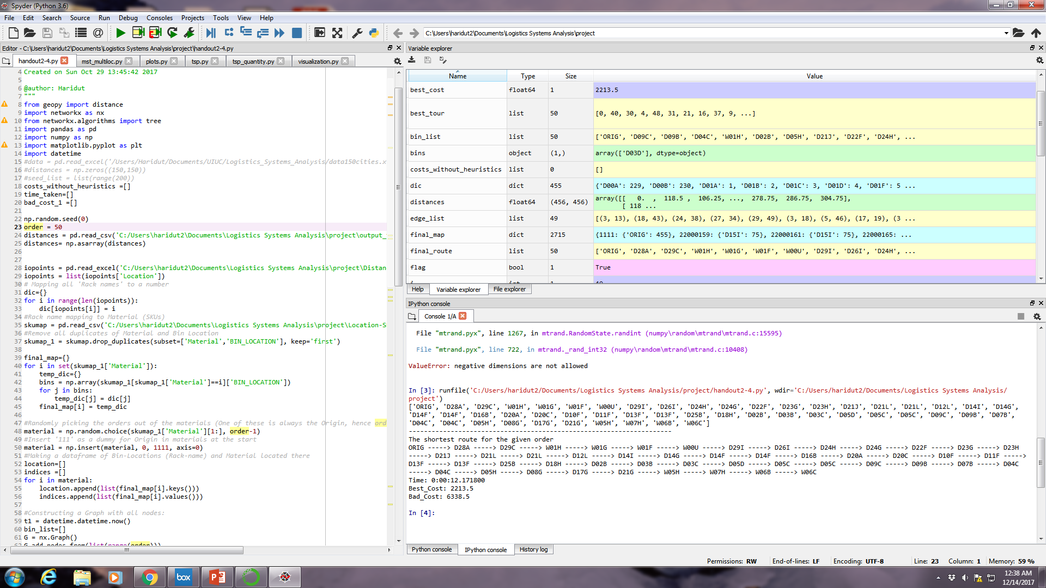
Sample Output

Slide 17
Results
Not only does the MST based Heuristic perform faster (on 50000 iterations), it’s output is also comparable to that of the optimal procedure.

Slide 18
Results
How do our heuristics help in saving cost ? (for an order size of 50 SKUs)

Slide 19
Results
What is the effect of including quantity ?

Slide 20


